Slide 1

Comparison of Ride Pattern of Membership Holders and Casual Riders.
Presented by – Ayush Adhikari
Last Updated on – 10th May 2022.

Slide 2
Introduction
I am working as a junior data analyst for a company Cyclistic.
Agenda –
Objectives
Data Source
Findings
Recommendation

Slide 3
Objectives
Business Task –
To analyze how annual members and casual riders use Cyclistic bikes differently in order to determine the best marketing strategy to convert casual riders into annual members.
Notes:
The problem is to make casual riders buy memberships.

Slide 4
Data Source
Data Used -
Data was filtered from 1st January 2021 to 31st December 2021.
Data anomalies were cleared as much as possible without affecting its accuracy and usefulness.
https://divvy-tripdata.s3.amazonaws.com/index.html

Slide 5
Findings
Number of Rides
Overall
Per month
Per quarter
Per Weekday
Top 30 stations for each type of rider.
Most preferred type of bike.
Member
Casual

Slide 6
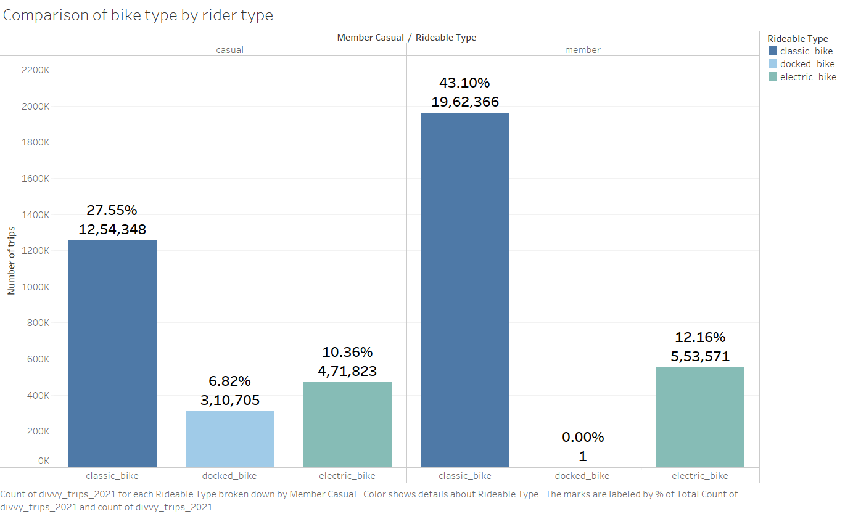
Overall number of rides
Findings-
Classic bikes are the most preferred bikes by both casual riders and membership holders.
2) Apprx 78% of membership holders prefer classic bikes whereas 61.5% of casual riders prefer the classic bikes.

Slide 7
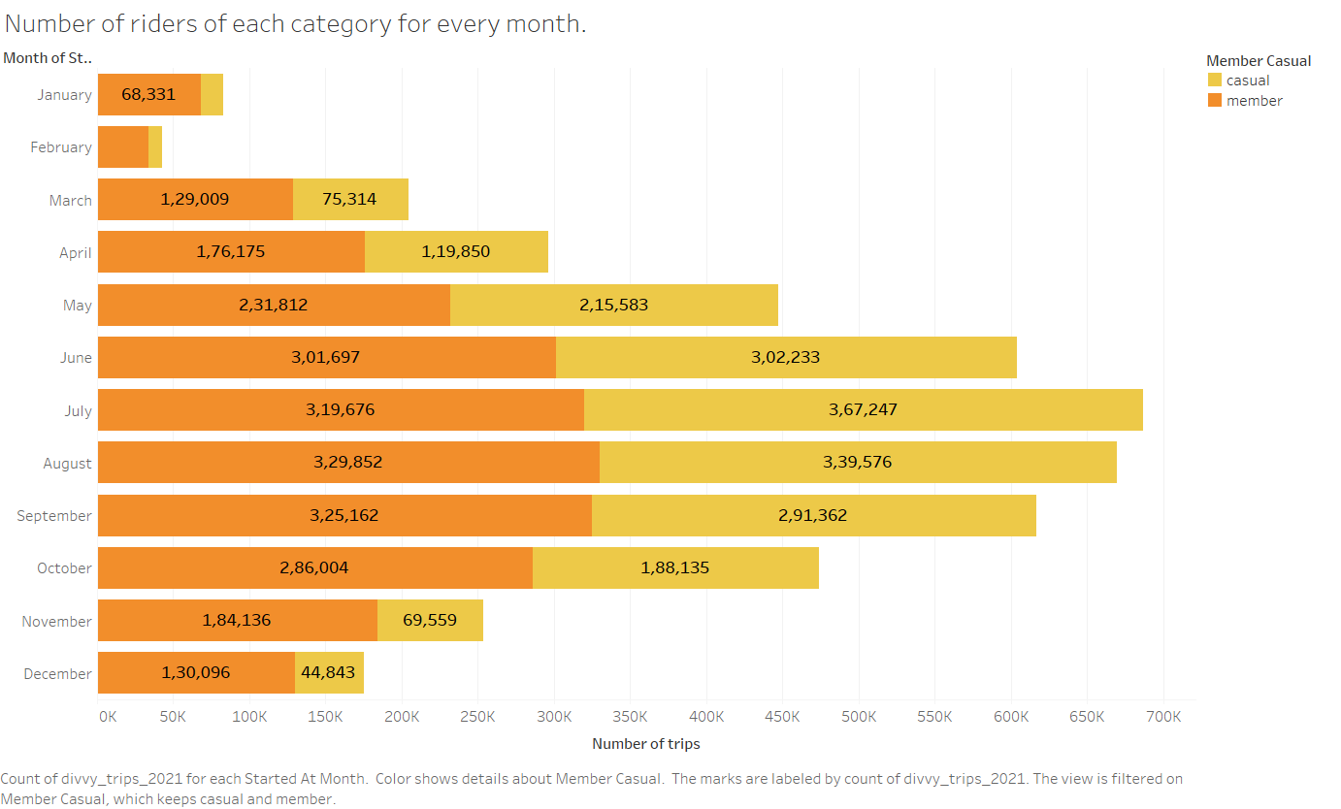
Number of trips per Month
Findings –
Membership holders completed more trips than casual rides for all months except July and August.
Data is not sufficient to judge whether this pattern repeats itself for different years as well.

Slide 8
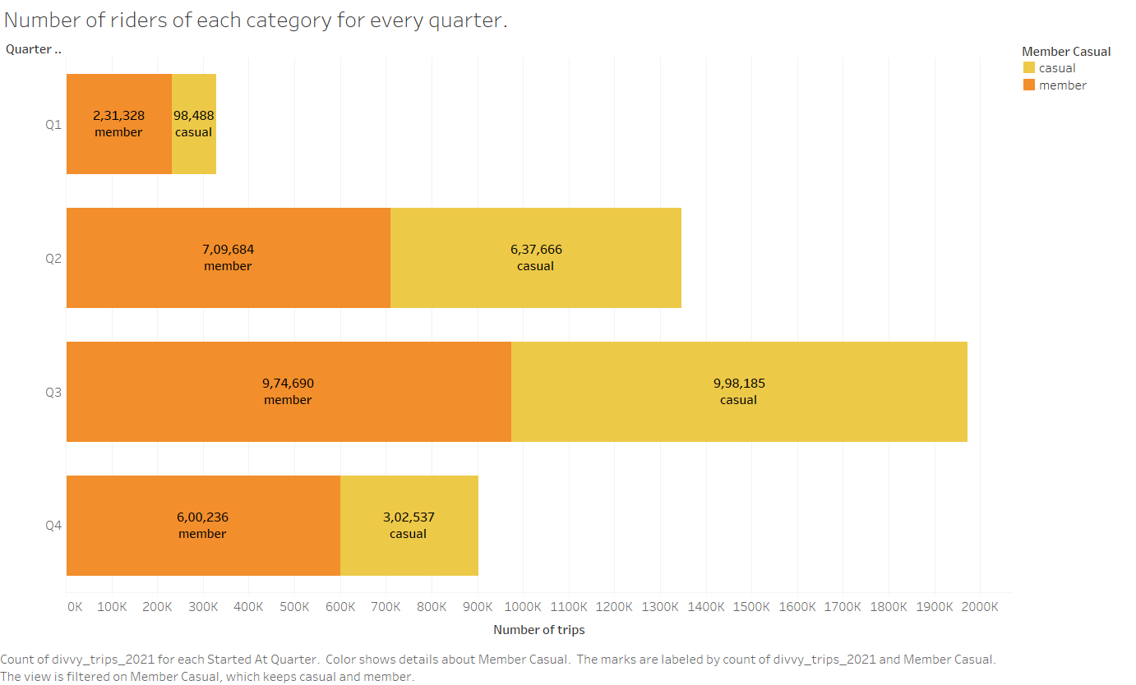
Number of trips per Quarter
Findings –
Third quarter was the busiest quarter for Cyclistic.
2) Membership holders outnumbered casual riders for all quarters except third quarter where the number of casual riders were 28K more.

Slide 9
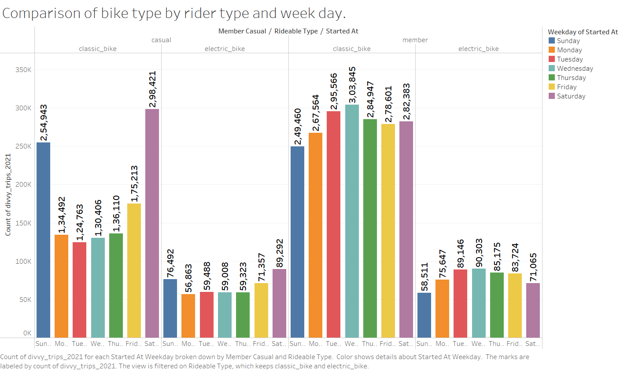
Number of trips per Weekday
Findings –
Weekends were the most busy days for casual riders.
In case of members Wednesday was the most busy day with Monday to Friday almost equally busy.
Both casual riders ad members greatly preferred classic bikes to the electric bikes.

Slide 10
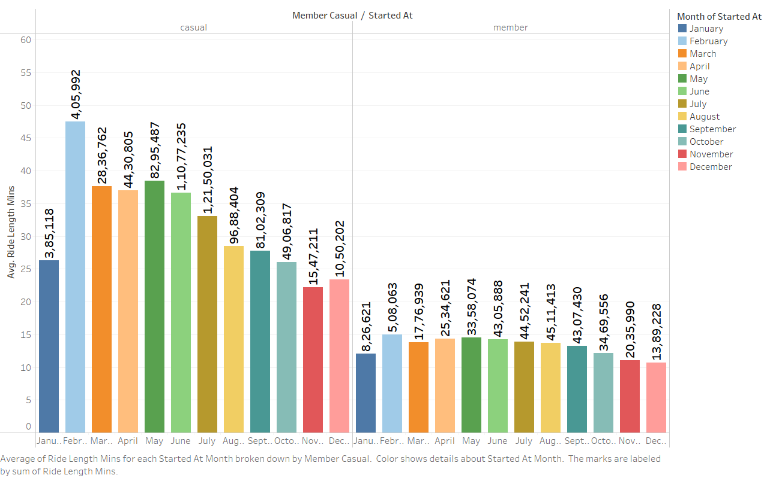
Average Ride Length per Month and Rider Type
Findings –
The average ride was maximum in month of Feb both for Casual riders and Members.
It was significantly higher in case of Casual Riders.
Average Ride Length was lowest in January for both type of Riders.

Slide 11
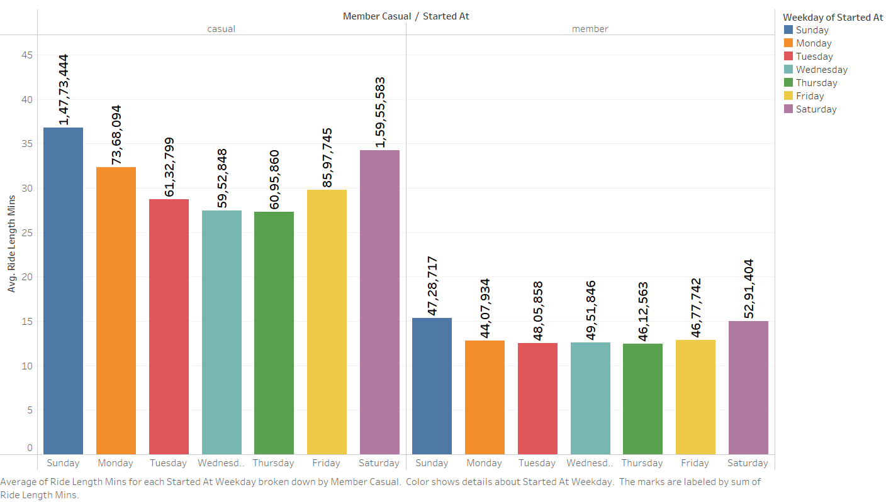
Average Ride Length per Weekday
Findings –
Earlier it was stated that Weekends were the most busy days for casual riders and the similar trend is shown here with Saturday and Sunday having maximum Average Ride Length.
The trend is somewhat similar in case of Members as well.

Slide 12
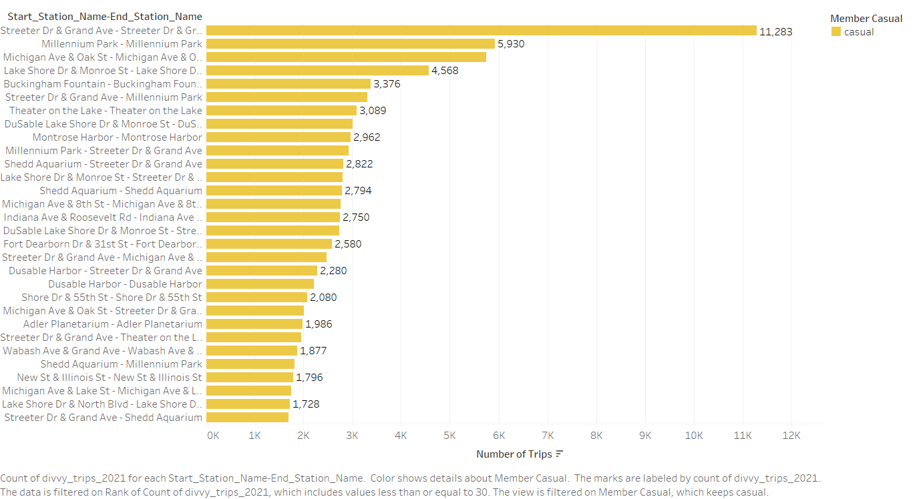
Top 30 Stations for Casual Riders.
Findings –
Return trip from and to Streeter Dr & Grand Ave is the most common trip by a large margin.
It is followed by Millennium Park round trip and Michigan Ave round trip.

Slide 13
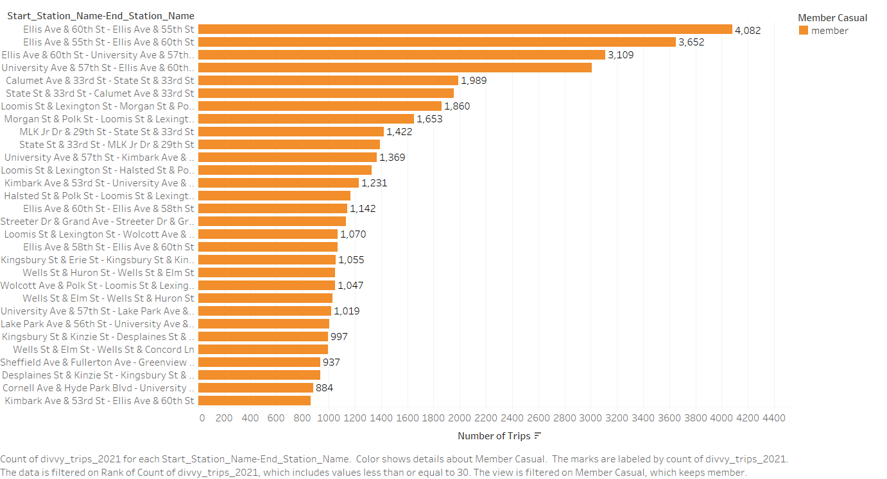
Top 30 Stations for Membership Holders.
Findings –
Return trip from Ellis Ave & 60th Street and to Ellis Ave & 55th Street is the most common trip.
It is closely followed by return trip from 55th Street to 60th Street.
Ellis Ave & 60th Street is the busiest street for members.

Slide 14
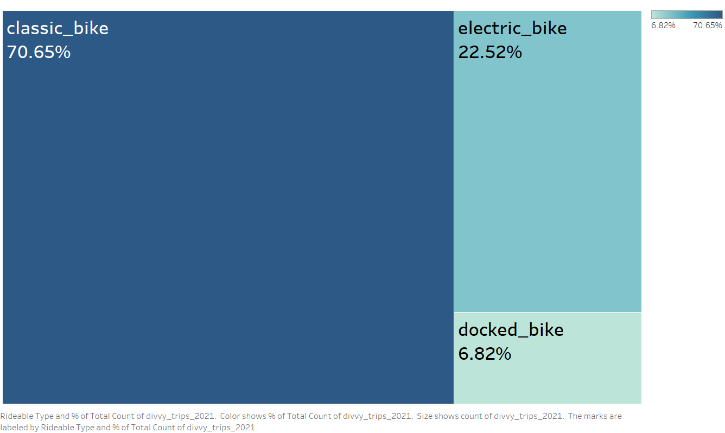
Percentage share of total rides by bike type
Findings –
Classic bikes are by far the most preferred bikes among the different types.
Docked bikes were the least preferred.

Slide 15
Key Takeaways
1) Ellis Ave & 60th Street, Ellis Ave & 59th Street were the busiest stations for membership holders and Streeter Dr and Grand Ave was the busiest station for casual riders.
a) Since these stations are the busiest ones they should be properly managed and efforts should be targeted here.
2) Classic Bikes are by far the most wanted bikes, so it should be seen that these bikes are properly maintained. In order to promote electric bikes usage coupons can be provided for the same.
3) A small percentage of casual bike users’ travel routine is comparable to the membership holders. So converting them into members should be one of the top priorities.
4) Since casual people do not take rides on weekdays, coupons on becoming members can promote conversions.

Slide 16
Next Steps
1) The data in the website is quite unclean and steps can be taken to prevent the same.
a) There were a lot of trips where the time duration of rides was either 0 mins or negative.
b) Various start stations and/or end stations were warehouses.
c) Many records had start stations’ and/or end stations’ names as blank.
d) Ride ID’s were not null in some records..
2) Rider usage data – asking the riders pertinent questions (eg, via survey)
Why do they use the bikes? For work, leisure?
3) Giving discounts on memberships to casual riders who partake in long rides. And free membership to the user who covered maximum distance in a month.
4) Paying special attention to the top start_stations that casual users choose most. More promotional activities on these stations can attract casual riders for membership.

Slide 17

Thanks

